Slide 1
Squad AI
Sohrab Namazi Nia

Slide 2
Contents
Introduction
Squad Based AI (famous FPS Games)
Squad Bases AI Analysis (practical example - Unity)
Genetic Algorithms

Slide 3
Introduction

Slide 4
Squad Game & AI
In squad-based games, there are a set of characters who are gathered to reach a goal or avoid a player from reaching a goal.
Artificial Intelligence has a lot of applications in games.
Artificial Intelligence has been widely used in Squad-Based games so that agents try to collaborate smartly to reach the goal. This factor makes the game more realistic and exciting for the gamers.

Slide 5
Squad Based AI (FPS Games)

Slide 6
Viectong (2003)
Viectong made some overlooked advances in Squad-based Intelligence.
Portraying a Special Forces unit in the Vietnam War, each squad member had a specific role. The squad reacted to enemy presence and automatically fired on enemy positions
While these features are common in newer FPS games, Vietcong should be credited as one of the first to experiment with integrating AI players with a command system.

Slide 7
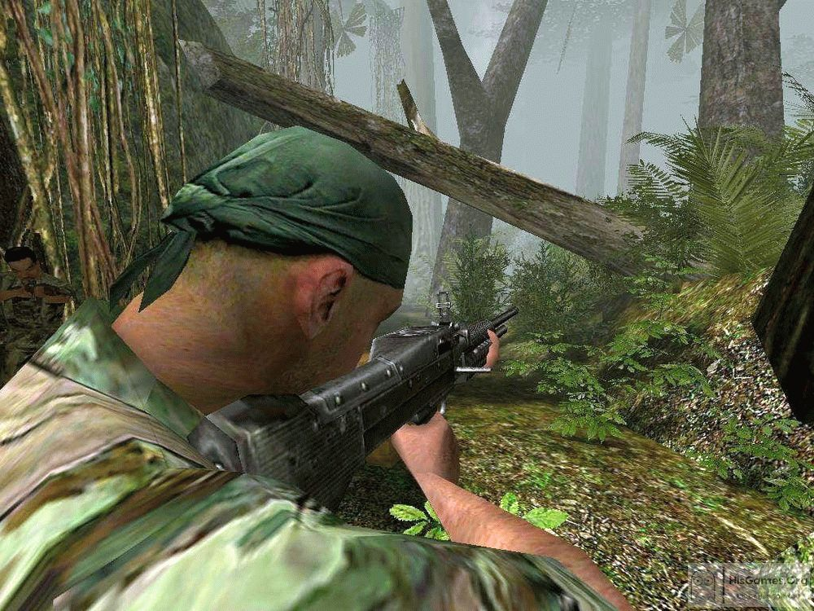
Viectong (2003)

Slide 8
Farcry (2004)
Far Cry also boasted advanced AI. While Jack Carver was a one-man army, his opponents were mercenaries trained to operate together.
Rarely seen alone, mercenaries shouted the player's location to each other, issued orders and gathered reinforcements to overwhelm the player.
The AI could have been more coherent and flexible, but the enemies' damage tolerance and tenacity provided a significant challenge for gamers.

Slide 9
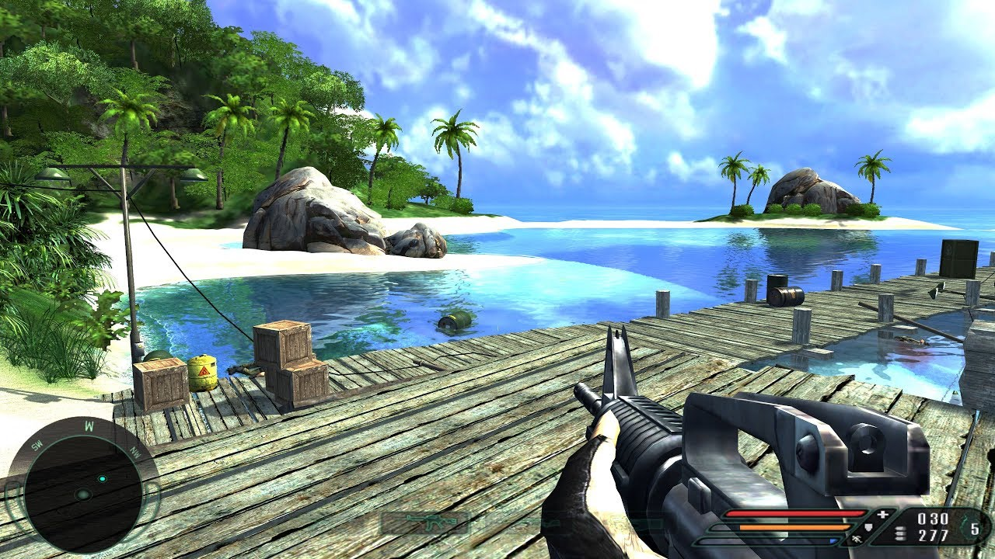
Farcry (2004)
Far Cry also boasted advanced AI. While Jack Carver was a one-man army, his opponents were mercenaries trained to operate together.
Rarely seen alone, mercenaries shouted the player's location to each other, issued orders and gathered reinforcements to overwhelm the player.
The AI could have been more coherent and flexible, but the enemies' damage tolerance and tenacity provided a significant challenge for gamers.

Slide 10
Farcry AI: Analysis
Farcry3 and Farcry4 improved the previous versions in many different aspects. with maps not only increasing in size but also with the introduction of more interactive environments and wildlife.
given designers need to balance the players sense of importance and agency. Similarly, there’s also the implementation issues faced in managing open world assets.
much of it stemmed from the pioneering works found in Left 4 Dead. Turtle Rock and Valve’s survival shooter focused on the distribution of enemy characters within close proximity of the player and Far Cry follows suit.
The original Farcry (2004) is an action heavy first-person shooter that gave the illusion of open-world gameplay, although it was so limited.

Slide 11

Farcry AI: Analysis
Farcry3 and Farcry4 improved the previous versions in many different aspects. with maps not only increasing in size but also with the introduction of more interactive environments and wildlife.
given designers need to balance the players sense of importance and agency. Similarly, there’s also the implementation issues faced in managing open world assets.
much of it stemmed from the pioneering works found in Left 4 Dead. Turtle Rock and Valve’s survival shooter focused on the distribution of enemy characters within close proximity of the player and Far Cry follows suit.
The original Farcry (2004) is an action heavy first-person shooter that gave the illusion of open-world gameplay, although it was so limited.

Slide 12
Farcry AI: Analysis
2008's Far Cry 2 was the first in the series to truly embrace the notions of open world play and more importantly, systemic design.
systemic design: the ability to have a range of independent systems and mechanics that can be combined in fun and interesting ways.
The opposing human factions, reactive and aggressive wildlife, combined with vehicles, environmental effects and more are intended to for players to exploit for their own personal gains.
Far Cry 2 is a bit of a frustrating experience, largely because these systems were not properly balanced or constrained.

Slide 13
Farcry AI: Analysis
Continued development of these systems lead to their adoption in 2012’s Far Cry 3.
2014’s Far Cry 4 attempted to improve upon what Far Cry 3 achieved while also addressing some of its criticisms: notably the balance of the systemic design
This systemic AI mostly is based on NPC (Non-Player Characters)
NPC in Farcry:
the enemies
the civilians
allied fighters to the animals that prowl the open-world maps
It just needs to know where and when to put them in the world.

Slide 14

Farcry AI: Analysis
2008's Far Cry 2 was the first in the series to truly embrace the notions of open world play and more importantly, systemic design.
systemic design: the ability to have a range of independent systems and mechanics that can be combined in fun and interesting ways.
The opposing human factions, reactive and aggressive wildlife, combined with vehicles, environmental effects and more are intended to for players to exploit for their own personal gains.
Far Cry 2 is a bit of a frustrating experience, largely because these systems were not properly balanced or constrained.

Slide 15
Farcry AI: Analysis
In order to maintain decent performance - given that these games not only have to run efficiently on PC but also between console generations - the following tricks are implemented in the game:
Far Cry’s dirty little secret: that at any point in time, the game is only maintaining active non-player characters within less than 500 meters of the player, with enemy characters and animals being added and removed to the world as the player moves around.
The NPCs within the game are designed to react and behave in a context-driven fashion: to attack, evade or explore areas of the map based on what’s happening around them. This is driven by finite state machines (FSMs)

Slide 16
Farcry AI: Analysis
Systematic element constraint: constrain the number of enemy NPCs, but also animals and items such as vehicles given the additional computational load they bring with them. In fact, in Far Cry 3 the numbers are really limited: with only 12 NPCs max in the world at once and up to 20 animals, with vehicles also limited to around 2 or 3 types at any point in time. For example, If you’re running in a particular direction, the system will spawn enemies in front of you: factoring not only your heading but your current speed: thus ensuring they don’t pop-up in front of you.
This system was enhanced for Far Cry 4 to become to create more interesting and varied events. Placing the NPCs in the world is one thing, but placing them in specific configurations related to one another can result in the player becoming involved in more engaging experiences. As such, Far Cry 4 introduced a dynamic encounter method that procedurally generates events within proximity of the player

Slide 17

Farcry AI: Analysis
Systematic element constraint: constrain the number of enemy NPCs, but also animals and items such as vehicles given the additional computational load they bring with them. In fact, in Far Cry 3 the numbers are really limited: with only 12 NPCs max in the world at once and up to 20 animals, with vehicles also limited to around 2 or 3 types at any point in time. For example, If you’re running in a particular direction, the system will spawn enemies in front of you: factoring not only your heading but your current speed: thus ensuring they don’t pop-up in front of you.
This system was enhanced for Far Cry 4 to become to create more interesting and varied events. Placing the NPCs in the world is one thing, but placing them in specific configurations related to one another can result in the player becoming involved in more engaging experiences. As such, Far Cry 4introduced a dynamic encounter method that procedurally generates events within proximity of the player

Slide 18

GTA V: LSPD
Instead of having x-ray vision and instantly knowing your
location like in GTA IV, In GTA V, The LSPD now search for you. Each squad (1 squad = 2 officers), helicopter, NOOSE Unit, etc. Has a cone which is the area they're looking at to try and find you.
When 2 officers get into one squad (1 car) they form one cone
unlike when the two officers split up to form two smaller cones.
The biggest cones are the helicopters have which makes sense as they're in the air.

Slide 19
GTA V: LSPD
Instead of having x-ray vision and instantly knowing your
location like in GTA IV, In GTA V, The LSPD now search for you. Each squad (1 squad = 2 officers), helicopter, etc. Has a cone which is the area they're looking at to try and find you.
When 2 officers get into one squad (1 car) they form one cone
unlike when the two officers split up to form two smaller cones.
The biggest cones are the helicopters have which makes sense as they're in the air.

Slide 20

FIFA 22: Squad AI

Slide 21
FIFA 22: Squad AI
With the overhaul of tactical AI, all players are expected to impress with greater intelligence on the pitch. "Every single player gets the ability to understand offensive and defensive formations and movements even better. This provides unimagined tactical realism," EA announces. The only negative is that the feature is exclusive to the next-gen consoles.

Slide 22
FIFA 22: Squad AI
On offense:
Players are now able to make up to six times more decisions per second, which significantly reduces the time needed for decision-making. This should lead to players being much more aware of their surroundings, which gives them a better overview of how their own team is standing and acting. Among other things, this allows players to start smarter runs in the build-up and react with more speed to free balls.

Slide 23
FIFA 22: Squad AI
On Defense:
Thanks to the new tactical AI, the teams will be able to act more as a unit. When moving across the pitch, the players will keep their formation, move in line and cleverly cover any gaps that occur. The times when the defense is unsorted and wrongly positioned should be a thing of the past. With the tactical AI, defending will hopefully play a bigger role in FIFA 22 than in previous FIFA releases.

Slide 24
Squad Based AI (Practical example)

Slide 25
Squad Based AI in action!
This game is an advanced AI system that makes the NPCs 'aware' of their teammates and form squads to solve combat related tasks.
These tasks can for example be:
Fighting opponents: using covers, tactical retreats, communicating within the squad and taking actions accordingly.
Walking in formation according to the situation.
Clearing buildings: where the squad line up at the door, enter the building and clear it.
The implemented concepts that are related to squad based AI:
Cover system: if a cover script is added to an object in Unity, the script will automatically calculate how many soldiers is able to use the cover at the same time and which side of the cover is the 'active' side, using the dimensions of the cover and the player position.
Squad Manager: For every squad, there is a squad manager object, that contains info about each member. This way, when the members communicate, they send a command to the squad manager and the squad manager makes sure every member in that squad does their part.
Entering buildings: tactically by stacking up and entering on command.

Slide 26
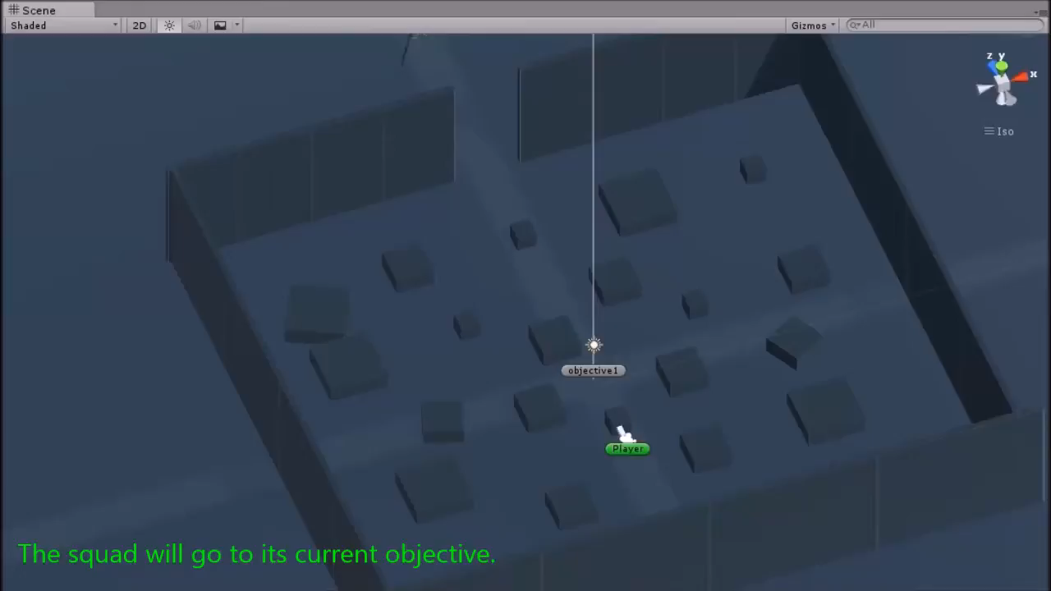

Slide 27
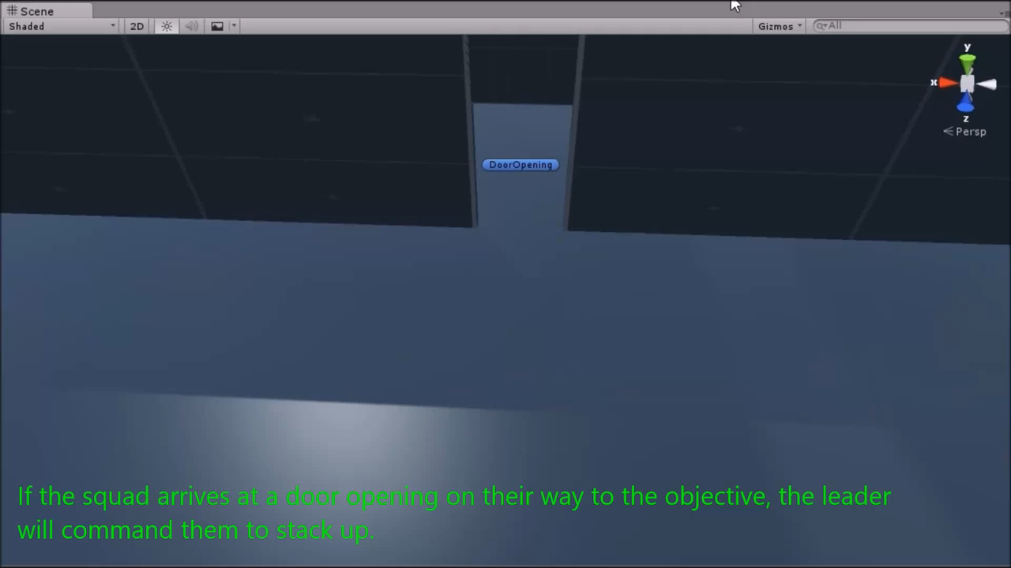

Slide 28
Genetic Algorithms

Slide 29
Genetic Algorithms
The genetic algorithm can be used in computer games - for example, to allow an enemy opponent to adapt in order to cater against an effective but repetitive tactic exhibited by a human player. This allows for a more realistic game experience; if a human player can find a sequence of steps which, repeated in different games always lead to success, there can be no challenge left. Conversely if a learning technique such as a genetic algorithm for a strategist can avoid repeating past mistakes, the game will have increased playability.

Slide 30
Genetic Algorithms
Generally, genetic algorithms contain of the following components:
Initial population
Fitness function
Selection
Crossover
Mutation
You can see a practical explanation of these steps here: Game - Genetic Algorithm

Slide 31
Resources
https://www.gamedeveloper.com/programming/the-definition-of-artificial-insanity-the-systemic-ai-of-far-cry
https://www.youtube.com/watch?v=3tb9DLqMtF8
https://gamefaqs.gamespot.com/top10/526-the-top-10-squad-based-ai-in-fps-games
https://www.lcpdfr.com/forums/topic/24305-gta-v-police-ai/
https://forum.unity.com/threads/wip-squad-based-combat-ai-system.367301/
https://www.gamers-academy.com/blog/fifa-22-what-are-the-advantages-of-tactical-ai
https://www.youtube.com/watch?v=3tb9DLqMtF8
https://www.youtube.com/watch?v=YUM_w96y07U
https://towardsdatascience.com/neural-network-genetic-algorithm-game-15320b3a44e3

Slide 32
Thank You

